Slide 1
PRODUCT RECOMMENDATION SYSTEM
Final Project presentation

Slide 2

Introduction

Slide 3
Introduction
Definition
Types
Dataset

Slide 4
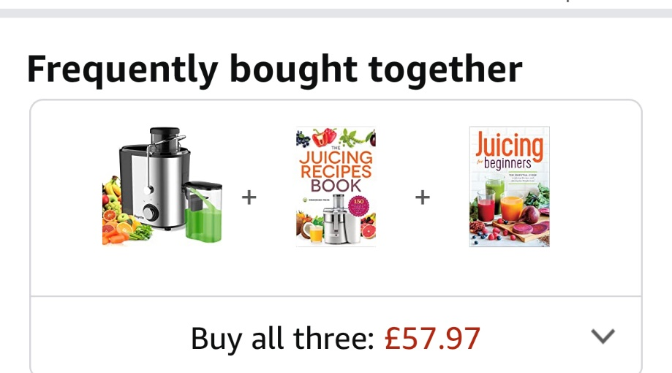
Collaborative Filtering Algorithm
User-User Collaborative Filtering
user-user filtering looks for look alike user and recommend products based on the habits of those other users.
Item-Item Collabotative Filtering
The item-item filtering techniques uses similar items to make suggestions.

Slide 5
Methods
Method 1
Method 2

Slide 6
Results
Result 1
Result 2

Slide 7
Conclusion
Conclusion

